Slide 1
UNIT 1: INTERPRETATION
1: The Value of Data + Data Narratives
2: Excel Fundamentals
3: Data Referencing
4: Data Aggregation
5: Data Visualization
6: Statistics in Excel*
James Larkin – Data Analytics Instructor
Notes:
* Indicates a FLEX lesson
Overview:
Working through aggregate functions (MIN, MAX, COUNTIF, COUNTA, etc) on the Washington census tract dataset (instructor demo)
Working through the same (ACS / washington census) dataset independently
Pivot table demo with the diamonds dataset
Pivot table guided practice with the ACS dataset
Conditional formatting, break-out, followed by guided with the diamond inventory dataset

Slide 2
DATA AGGREGATION IN EXCEL

Slide 3
DATA AGGREGATION IN EXCEL
OPENING

Slide 4
LEARNING OBJECTIVES
DATA AGGREGATION IN EXCEL
In today’s lesson, we will:
Learn to apply Excel aggregation commands to our data, including:
MIN, MAX, SUM, AVERAGE, COUNT, and their conditional variants.
COUNTIF, COUNTA, COUNTIFS, and COUNTBLANKS for summarizing data.
Summarize data using PivotTables and manage common problems.
Explore data using conditional formatting for categorization and analysis.

Slide 5
OPENING
Aggregate functions summarize data in various ways. These functions are helpful on their own, but they also play an integral role in using PivotTables.
PivotTables are tremendously helpful when creating summaries of data!

Slide 6
DATA AGGREGATION IN EXCEL
GUIDED PRACTICE: HOW TO USE AGGREGATE FUNCTIONS

Slide 7
WHAT ARE AGGREGATE FUNCTIONS?
Aggregate functions allow you to summarize information using formulas in Excel.
Let’s learn about Excel’s aggregate functions and apply them to our scavenger hunt.
Use the scavenger hunt (Washington census) dataset with the new functions we’re about to learn.
Notes:
Open the L4_scavenger_hunt.xlsx file now!!!

Slide 8
AGGREGATE FUNCTIONS: =MIN(...)
=MIN(...): Finds the minimum value of a range of numbers.
Syntax: =MIN(number1, [number2], ...)
Solution to our scavenger hunt: =MIN('2014_acs_select'!B:B)

Slide 9
AGGREGATE FUNCTIONS: =MAX(...)
=MAX(...): Finds the maximum value of a range of numbers.
Syntax: =MAX(number1, [number2], ...)
Solution to our scavenger hunt: =MAX('2014_acs_select'!O:O)

Slide 10
AGGREGATE FUNCTIONS: =SUM(...)
=SUM(...): Finds the sum of a range of numbers.
Syntax: =SUM(number1,[number2],...)
Solution to our scavenger hunt: =SUM('2014_acs_select'!E:E)

Slide 11
AGGREGATE FUNCTIONS: =AVERAGE(...)
=AVERAGE(...): Finds the average of a range of numbers.
Syntax: =AVERAGE(number1, [number2], ...)
Solution to our scavenger hunt: =AVERAGE('2014_acs_select'!AI:AI)

Slide 12
AGGREGATE FUNCTIONS: =COUNT(...)
=COUNT(...): Counts the number of numeric values in a range.
Syntax: =COUNT(value1, [value2], ...)
Solution to our scavenger hunt: =COUNT('2014_acs_select'!D:D)

Slide 13
AGGREGATE FUNCTIONS: =COUNTIF(...)
=COUNTIF(...): Counts the number of values in a range that meet the given criteria.
Syntax: =COUNTIF(range, criteria)
Solution to our scavenger hunt:
Part A: =COUNTIF('2014_acs_select'!B:B,"<25")
Part B: =COUNTIF('2014_acs_select'!AL:AL,"=High")
Notes:
Instructor Talking Point: Note that for the solution to Part B, the criteria has to be in double quotes (“...”).

Slide 14
AGGREGATE FUNCTIONS: =COUNTIFS(...)
=COUNTIFS(...): Similar to COUNTIF, this counts the number of values in a range using specific criteria, except this method can take many ranges with many criteria. Has a logical AND relationship between arguments.
Syntax: =COUNTIFS(criteria_range1, criteria1, [criteria_range2, criteria2]…)
Solution to our scavenger hunt: =COUNTIFS('2014_acs_select'!C:C,"<35",'2014_acs_select'!D:D,">=35")
Notes:
Note: This is a useful method for nesting formulas

Slide 15
AGGREGATE FUNCTIONS: =COUNTA(...)
=COUNTA(...): Counts the number of non-blank cells, (numeric OR text) not just the number of numeric cells.
Syntax: =COUNTA(value1,[value2], ...)
Solution to our scavenger hunt: =COUNTA('2014_acs_select'!A:A)-1
Notes:
Instructor Solution Note: We have to subtract 1 to avoid the header row.

Slide 16
AGGREGATE FUNCTIONS: =COUNTBLANK (...)
=COUNTBLANK(...): Counts the number of blank cells in the range. This is the complement to COUNTA.
Syntax: =COUNTBLANK(range)
Solution to our scavenger hunt: =COUNTBLANK('2014_acs_select'!A1:AM1446)

Slide 17
DATA AGGREGATION IN EXCEL
INDEPENDENT PRACTICE: USING AGGREGATE FUNCTIONS

Slide 18

BREAK OUT ACTIVITY: USING AGGREGATE FUNCTIONS
DIRECTIONS
EXERCISE
Open “L4_independent_activity_p1.xlsx.” (ACS data)
Based on your experience, choose to complete either the BASE or STRETCH tab (20 min).
You may work with a partner, checking in with each other after answering each question.
DELIVERABLE
Complete BASE or STRETCH tab in “L4_independent_activity_p1.xlsx.”

Slide 19
DATA AGGREGATION IN EXCEL
INTRODUCTION: PIVOT TABLES

Slide 20
INTRODUCTION TO PIVOT TABLES
PivotTables allow you to quickly create dynamic aggregations, slices, and filters.
Unlike static charts, this means a PivotTable allows you to use your data as an active source — without having to write your own formulas.
PivotTables are an extensive topic — entire books have been written about them — but in this lesson learn enough to use them efficiently.
Notes:
Instructor Note: The dynamic aspect is worth emphasizing, since it comes up in most classes. Also, many novice students get hung up on the fact that they can't do quick calculations based off of data they see in the pivot table.
When you go to PivotTable Analyze -> Options -> down arrow, you will see a checkmark next to "get pivot data." We suggest unchecking it because it allows you easier access to the data. For a deeper explanation, look here: https://support.office.com/en-us/article/GETPIVOTDATA-function-8c083b99-a922-4ca0-af5e-3af55960761f

Slide 21
DATA AGGREGATION IN EXCEL
DEMO:
PIVOT TABLE COMPONENTS

Slide 22
DIAMONDS DATASET: DESCRIPTION
We’ll demonstrate how to use PivotTables on the Diamonds dataset. This dataset has 10 variables:
Price: Price in U.S. dollars ($326–$18,823).
Carat: Weight of the diamond (0.2–5.01).
Cut: Quality of the cut (fair, good, very good, premium, ideal).
Color: Diamond color, from J (worst) to D (best).
Clarity: A measurement of how clear the diamond is (I1 (worst), SI1, SI2, VS1, VS2, VVS1, VVS2, IF (best)).
X: Length in mm (0–10.74).
Y: Width in mm (0–58.9).
Z: Depth in mm (0–31.8).
Depth: Total depth percentage = z / mean(x, y) = 2 * z / (x + y) (43–79).
Table: Width of top of diamond relative to widest point (43–95).

Slide 23
CREATE A PIVOTTABLE
Open the spreadsheet labeled “Diamond_Inventory.xlsx.”
Create a PivotTable by clicking “PivotTable” on the Insert ribbon under the Data heading.
Make sure you have a cell selected in the diamond data to pre-populate the range.
Verify that the table/range auto-selected is the diamonds data.
If not, you can change it before moving on.
Decide where you want to put the PivotTable.
Let’s create a new worksheet for this example (which is the default option).
Click OK.

Slide 24
COMPONENTS OF A PIVOT TABLE
PivotTables have four primary components: filters, rows, columns, and values.
Filters: Which data should we include in our PivotTable?
We’ll start by filtering out any data we don’t want to include.
Rows: What unique data values do we want to have as rows in our table?
These values must exist in the data. If they don’t, you’ll need to create them first.

Slide 25
COMPONENTS OF A PIVOT TABLE
PivotTables have four primary components: filters, rows, columns, and values.
3. Columns: What unique data values do we want to have as columns in our table?
These values must already exist.
4. Values: These are the values that will be in the cells of our table.
To create them, we’ll have to tell Excel how we want them aggregated using the aggregation functions we’ve already learned.

Slide 26
CREATING A PIVOT TABLE
Let’s demonstrate by finding the average price per color in our Diamonds data:
Drag “color” to Rows.
Drag “price” to Values.
To fix the average price, click “i” next to “Sum of price” in Values.
Change “Summarize by” to “Average.”
This will properly take the average, but let’s make sure our formatting is correct.
These averages are dollar amounts, so go to “Format > Cells > Number” and select Currency.

Slide 27
CREATING A PIVOT TABLE
Next, let’s find the average price per color and cut:
If we want to calculate the average price per color and per cut, drag “cut” into Rows.
For every color, we now see the price per each color and each cut.
What if we wanted cut and then color? Change the order and see the results.
It’d be much easier to parse and compare this data if the colors were down the rows and the cuts were across the columns.
Move “cut” to Columns.

Slide 28
CREATING A PIVOT TABLE
Next, let’s find the average price per color and cut for the top three best clarities:
For this, the structure of our PivotTable is going to remain the same, but we need to filter some of the data out of the calculations.
Move “clarity” to Filter.
Notice that a dropdown for clarity has been added above the PivotTable. Use the dropdown to filter out only VVS1, VVS2, and IF.

Slide 29
CREATING A PIVOT TABLE
Last, let’s identify the number of diamonds by cut, color, and clarity:
Move “cut,” “color,” and “clarity” to Rows.
Change “Average of price” to “Count of price.”
Reformat this into a number.
When doing a count, you can often use any of the variables for Values, as long as they have values of some kind.
Think of this as counting the number of values for a given column. Because the table is a rectangle, this also gives you the number of observations.

Slide 30
PIVOT TABLES SUMMARY
PivotTables work well with this data set because the data is not aggregated.
Each row defines only one observation (one diamond) and contains many categorical variables.
Categorical variables are especially important for PivotTables because a PivotTable will always turn a variable into a categorical variable when it’s placed as a Row or Column.

Slide 31
DATA AGGREGATION IN EXCEL
GUIDED PRACTICE: PIVOT TABLES WITH ACS DATA
Notes:
Instructor Note: Open 2014_acs_select_WA_CLEAN.xlsx. Students can use this dataset or their own version that they prepared in Lesson 1. Solutions can be found in L4_pivot_demo_2.xlsx.
Walk through the following three examples. Below are the specifications of each pivot table and any required preparations to create the pivot table. Make sure to explain the reasoning behind each decision.
Example 1: Do rates of unemployment differ significantly by density?
Note: we already created a density_group definition in the last lesson.
Rows: density_group
Values: Unemployment Rate
Example 2: What are the minimum, average, and maximum sizes (in sq. km.) for census groups by density?
Rows: density_group
Values:
Min of area_sqkm
Average of area_sqkm
Max of area_sqkm
Example 3: What is the percentage of each county that lives within each type of density group?
Rows: county
Columns: density_group
Values: Total population
Set “Show Data As” to “% of Row”
Check: Ask students to read the pivot table created in example 3 for a specific county and density group.

Slide 32
PIVOT TABLES
Unlike the Diamonds dataset, our ACS data has been aggregated by census tract. Therefore, we’ll need to keep the following consideration in mind to ensure our PivotTables are accurate and streamlined:
Any values that we want in the rows or columns should be discrete, categorical variables.
In the case of our ACS data, this means we’ll need to create categorical data, like we did when calculating density in the last lesson.
Notes:
Instructor Talking Points: If our ACS data weren’t aggregated, it would be a set of people, not census tracts!

Slide 33
GUIDED PRACTICE: PIVOT TABLES
DIRECTIONS
Open “2014_acs_select_WA_CLEAN.xlsx."
Follow the three prompts (next 3 slides).
EXERCISE
DELIVERABLE
Answers to the prompts provided.

Slide 34
PIVOT TABLES WITH ACS DATA: BREAK OUT NO. 1
Question 1: Do rates of unemployment differ significantly by density?
Note: Remember, we created a “density_group “definition in our last lesson.
Rows: “density_group”
Values: unemployment rate
Notes:
Solutions can be found in L4_pivot_demo_2.xlsx. Example 1: Do rates of unemployment differ significantly by density?
Note: we already created a density_group definition in the last lesson.
Rows: density_group
Values: Unemployment Rate

Slide 35
PIVOT TABLES WITH ACS DATA: BREAK OUT NO. 2
Question 2: What are the minimum, average, and maximum sizes (in sq. km) for census groups by density?
Rows: “density_group”
Values:
Min of “area_sqkm”
Average of “area_sqkm”
Max of “area_sqkm”
Notes:
Example 2: What are the minimum, average, and maximum sizes (in sq. km.) for census groups by density?
Rows: density_group
Values:
Min of area_sqkm
Average of area_sqkm
Max of area_sqkm

Slide 36
PIVOT TABLES WITH ACS DATA: BREAK OUT NO. 3
Question 3: What percentage of each county lives within each type of density group?
Rows: “county”
Columns: “density_group”
Values: total population
Set “Show Data As” to “% of Row.”
Notes:
Example 3: What is the percentage of each county that lives within each type of density group?
Rows: county
Columns: density_group
Values: Total population
Set “Show Data As” to “% of Row”

Slide 37
DATA AGGREGATION IN EXCEL
COMMON PROBLEMS & SOLUTIONS FOR PIVOTTABLES

Slide 38

COMMON PIVOT TABLE SOLUTIONS
Notes:
OPTIONAL: Instructor Notes -
The following video can either be viewed in-class or shared with students.
It is 11:00 mins and describes 10 common pivot table issues and some simple solutions.
Depending on time, feel free to skip this and share with students after class.

Slide 39
DATA AGGREGATION IN EXCEL
INDEPENDENT PRACTICE: USING PIVOTTABLES

Slide 40
BREAK OUT ACTIVITY: USING AGGREGATE FUNCTIONS
DIRECTIONS
EXERCISE
Open “2014_acs_select_WA.xlsx.”
Based on your experience, choose to complete either the BASE or STRETCH tab (20 min).
You may work with a partner, checking in with each other after answering each question.
DELIVERABLE
Complete BASE or STRETCH tab in “2014_acs_select_WA.xlsx.”

Slide 41
DATA AGGREGATION IN EXCEL
CONDITIONAL FORMATTING ANALYSIS

Slide 42
CONDITIONAL FORMATTING ANALYSIS
Finally, we’ll briefly cover some pointers for conditional formatting:
Use conditional formatting to draw attention to specific parts of the data whenever they meet a predefined condition.
Conditional formatting is a great way to communicate a range or spectrum, or to visually demonstrate proportions within data.
Conditional formatting can also assist in showing values that have fallen outside the expected range, helping to identify outliers.

Slide 43
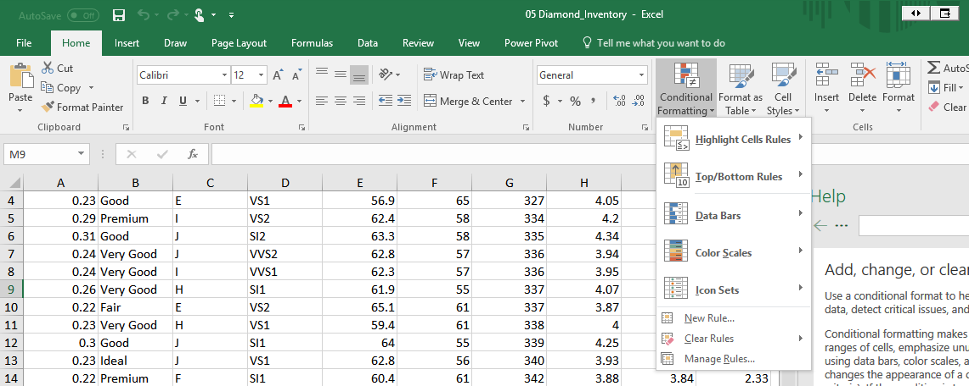
CONDITIONAL FORMATTING ANALYSIS
Access controls for conditional formatting on the top menu.
Create highlighting “rules” to manage the desired criteria.

Slide 44
BREAK OUT ACTIVITY: CONDITIONAL FORMATTING
DIRECTIONS
EXERCISE
Open the “Diamond Inventory” worksheet.
Add conditional formatting for columns indicating:
Table size, based on numerical rating using data bars.
Cut designation, by ranking the categories with individual colors.
You may work with a partner, checking in with each other after answering each question (20 min).
DELIVERABLE
The completed “Diamond Inventory” worksheet with conditional formatting implemented.

Slide 45
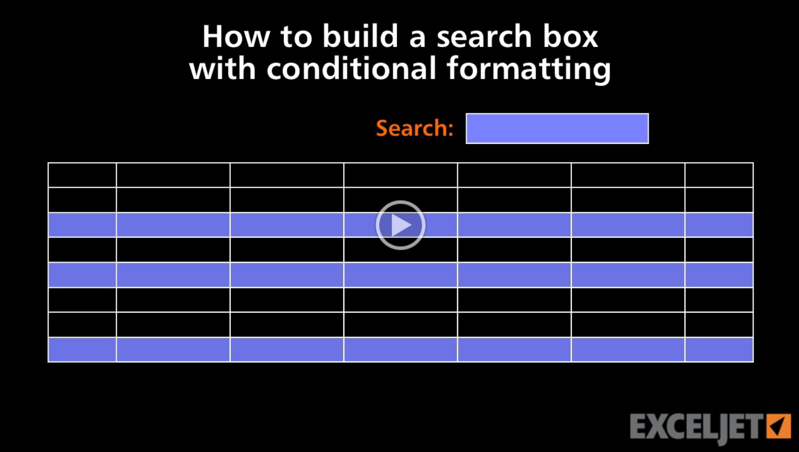
CONDITIONAL FORMATTING ANALYSIS: DIGGING DEEPER
Notes:
OPTIONAL: Like before, this video provides additional methods for using conditional formatting. The video is ~3:00 minutes and can be shown in class or recommended to students for take-home viewing. If shown in class, recommend that you follow it up with specific questions and prompts asking them how they could apply what they just learned.

Slide 46
DATA AGGREGATION IN EXCEL
CONCLUSION

Slide 47
REVIEW: DATA AGGREGATION IN EXCEL
What did we accomplish in today’s lesson?
We learned how to use and apply various aggregate functions in order to summarize our data, including: MIN, MAX, SUM, AVERAGE, COUNT, COUNTIF, COUNTA, COUNTIFS, and COUNTBLANKS.
We defined how to use PivotTables and explained some of their many benefits:
Saving time, creating aggregations, exploring slices of data
Note: PivotTable logic is an important topic that comes up again in later units, so practice and review materials accordingly!
We applied conditional formatting with color and bars to our data set to quickly highlight specific characteristics.

Slide 48
DATA AGGREGATION IN EXCEL
HOMEWORK

Slide 49
DATA AGGREGATION IN EXCEL
Q&A

Slide 50
DATA AGGREGATION IN EXCEL
RESOURCES

Slide 51
RESOURCES
DATA AGGREGATION IN EXCEL
The Excel documentation on the Microsoft website is helpful when looking up the arguments and behavior of Excel functions: https://support.office.com/en-us/excel
Common PivotTable issues and solutions: https://youtu.be/P_0_zuvGYyU
ExcelJet on conditional formatting using a control window: https://youtu.be/aAOrhNHGQdg

Slide 52
DATA AGGREGATION IN EXCEL
EXIT TICKET
DON’T FORGET TO FILL OUT YOUR EXIT TICKET!

Slide 53
DATA AGGREGATION IN EXCEL
CREDITS

Slide 54
CITATIONS
DATA AGGREGATION IN EXCEL
Diamonds data set from ggplot2’s R package: http://docs.ggplot2.org/0.9.3.1/diamonds.html

